Slide 1
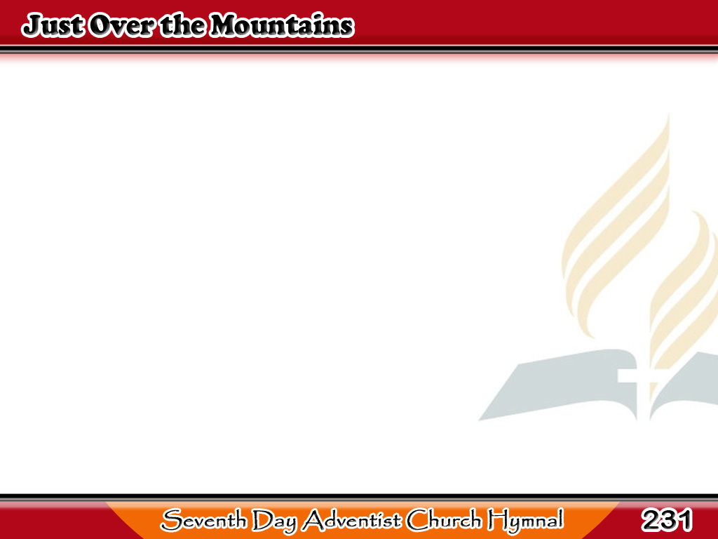
Sa Kabila ng mga Kabundukan
Just over the mountains
in the Promised Land,
Lies the holy city built
by God’s own hand;
1/4

Slide 2
Sa Kabila ng mga Kabundukan
As our weary footsteps
gain the mountain’s crest,
We can view our
homeland of eternal rest.
1/4

Slide 3
-Refrain-
Sa Kabila ng mga Kabundukan
We are nearing home! (2X)
See the splendor gleaming
from the domes afar!
See the glory streaming
through the “gates ajar!”
1/4

Slide 4
-Refrain-
Sa Kabila ng mga Kabundukan
There we soon will enter,
nevermore to roam,
Hear the angels singing!
We are nearing home!
We are nearing home.
1/4

Slide 5
Sa Kabila ng mga Kabundukan
In the rolls of the prophets
we have long been told
Of that wondrous city
with its streets of gold;
2/4

Slide 6
Sa Kabila ng mga Kabundukan
Now with raptured vision
we can see it there,
With its walls of jasper
and its mansions fair.
2/4

Slide 7
-Refrain-
Sa Kabila ng mga Kabundukan
We are nearing home! (2X)
See the splendor gleaming
from the domes afar!
See the glory streaming
through the “gates ajar!”
2/4

Slide 8
-Refrain-
Sa Kabila ng mga Kabundukan
There we soon will enter,
nevermore to roam,
Hear the angels singing!
We are nearing home!
We are nearing home.
2/4

Slide 9
Sa Kabila ng mga Kabundukan
Those who enter that city
are the faithful few
Who keep God’s commandments
faith of Jesus, too;
3/4

Slide 10
Sa Kabila ng mga Kabundukan
There we’ll lift our voices
through the endless days,
In sweet songs of gladness
and in psalms of praise.
3/4

Slide 11
-Refrain-
Sa Kabila ng mga Kabundukan
We are nearing home! (2X)
See the splendor gleaming
from the domes afar!
See the glory streaming
through the “gates ajar!”
3/4

Slide 12
-Refrain-
Sa Kabila ng mga Kabundukan
There we soon will enter,
nevermore to roam,
Hear the angels singing!
We are nearing home!
We are nearing home.
3/4

Slide 13
Sa Kabila ng mga Kabundukan
My brother, my sister,
will you meet us there,
In that land of sunshine
where there’ll be no care?
4/4

Slide 14
Sa Kabila ng mga Kabundukan
Accept of God’s message,
and to Him be true;
Then when Jesus cometh
He will call for you.
4/4

Slide 15
-Refrain-
Sa Kabila ng mga Kabundukan
We are nearing home! (2X)
See the splendor gleaming
from the domes afar!
See the glory streaming
through the “gates ajar!”
4/4

Slide 16
-Refrain-
Sa Kabila ng mga Kabundukan
There we soon will enter,
nevermore to roam,
Hear the angels singing!
We are nearing home!
We are nearing home.
4/4

